Slide 1

DEFAULT OF CREDIT CARD CLIENTS
AMIT ROVSHITZ AND MATAN ADAR

Slide 2


Our Team
MATAN ADAR
AMIT ROVSHITZ

Slide 3
PROCESS DESCRIPTION
We chose to predict whether a client will default on their credit card payment by a machine learning tool
We chose to use 5 machine learning algorithms:
Knn
Logistic Regression
PCA
Random Forest
Adaboost
Our dataset is the file call “default of credit card clients.csv”
(the link to download the dataset can be found in the file call “description”)
Notes:
נרצה לבדוק F1 כי הדאטא שלנו לא מאוזן
ונרצה לבחון AUC
כמה מקרים הצלחנו לאתר
שנרצה לדעת כמה הפסדים הצלחנו לצמצם בעזרת התחזיות שביצענו
ונרצה להסתכל גם על הAUC על הFPR כדי לדעת כמה מקרים
2 מקרים של הפסדים אפשריים:
1. סיווגנו כלא דיפולט ובסוף הוא עשה דיפולט ואז הפסדנו עליו
1. סיווגנו כדיפולט והוא לא ואז בעצם ביטלנו לו את האשראי ויכלנו להרוויח ממנו

Slide 4
OUR PROBLEM
PREDICT WHETHER A CLIENT WILL DEFAULT ON THEIR CREDIT CARD PAYMENT
FEATURES OF CREDIT CARD CLIENT
MITIGATE POTENTIAL LOSSES
EVALUATION: F1,ACCURACY,PRECISION,RECALL
Notes:
נרצה לבדוק F1 כי הדאטא שלנו לא מאוזן
ונרצה לבחון AUC
כמה מקרים הצלחנו לאתר
שנרצה לדעת כמה הפסדים הצלחנו לצמצם בעזרת התחזיות שביצענו
ונרצה להסתכל גם על הAUC על הFPR כדי לדעת כמה מקרים
2 מקרים של הפסדים אפשריים:
1. סיווגנו כלא דיפולט ובסוף הוא עשה דיפולט ואז הפסדנו עליו
1. סיווגנו כדיפולט והוא לא ואז בעצם ביטלנו לו את האשראי ויכלנו להרוויח ממנו

Slide 5
DATA DESCRIPTION
30000 INSTANCES 25 FEATURES
PERSONAL DATA: AGE,GENDER,EDUCATION, MARITAL STATUS
FINANCIAL DATA:
HISTORY OF PAST PAYMENT/DEBT
LIMIT BALANCE

Slide 6
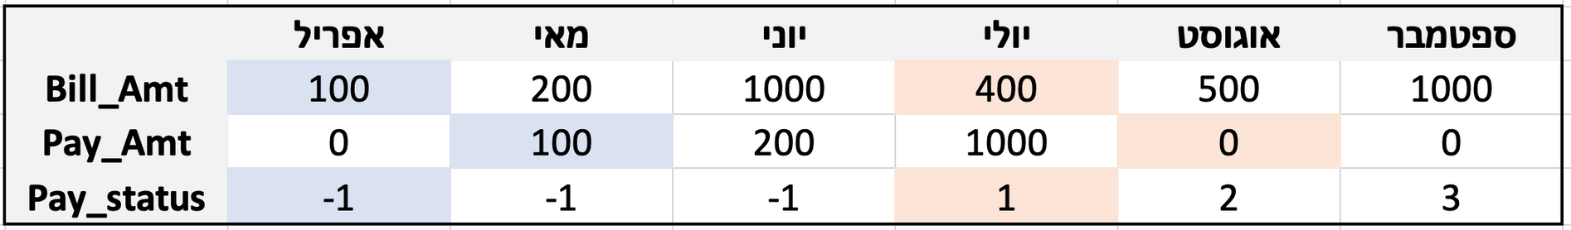
DATA DESCRIPTION

Slide 7
DATA DESCRIPTION
NA'S: MARRIAGE- 0.18% NA,
Education - 0.05% NA
30% TEST /70% TRAIN

Slide 8
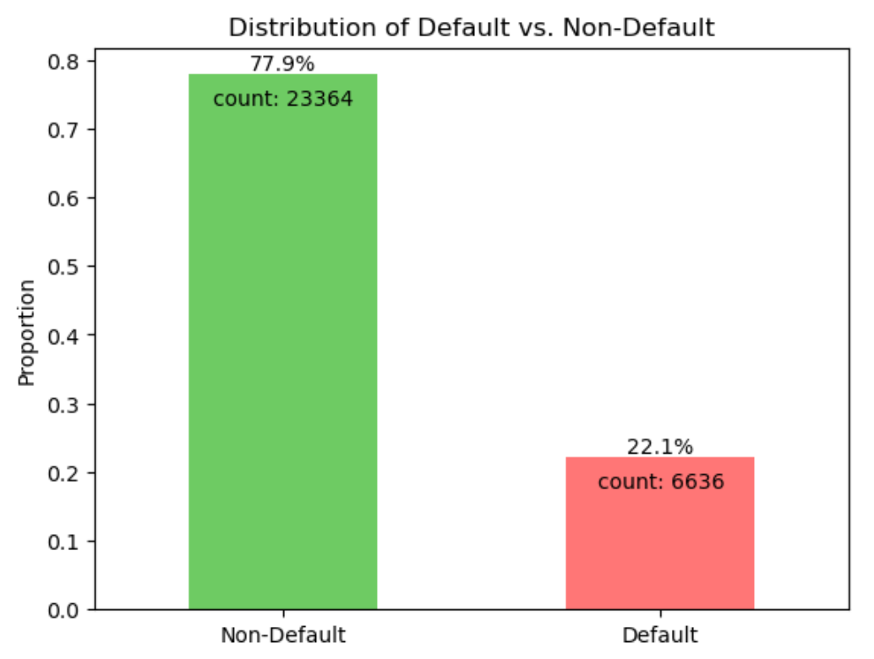
DATA DISTRIBUTION

Slide 9
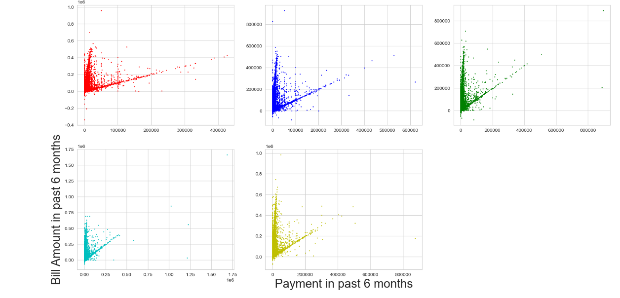
BILL vs. PAY
NEIL
TRAN
Content
Department

Slide 10
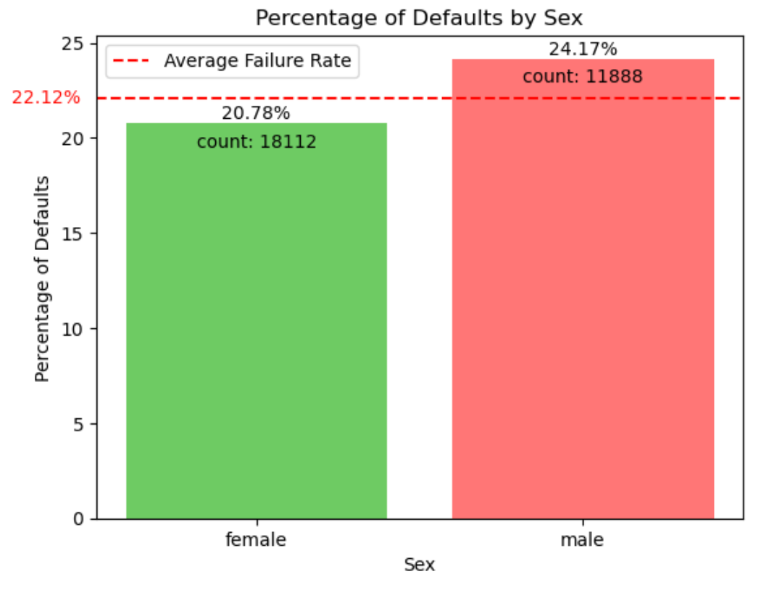
DEFAULTERS BY GENDER
NEIL
TRAN
Content
Department

Slide 11
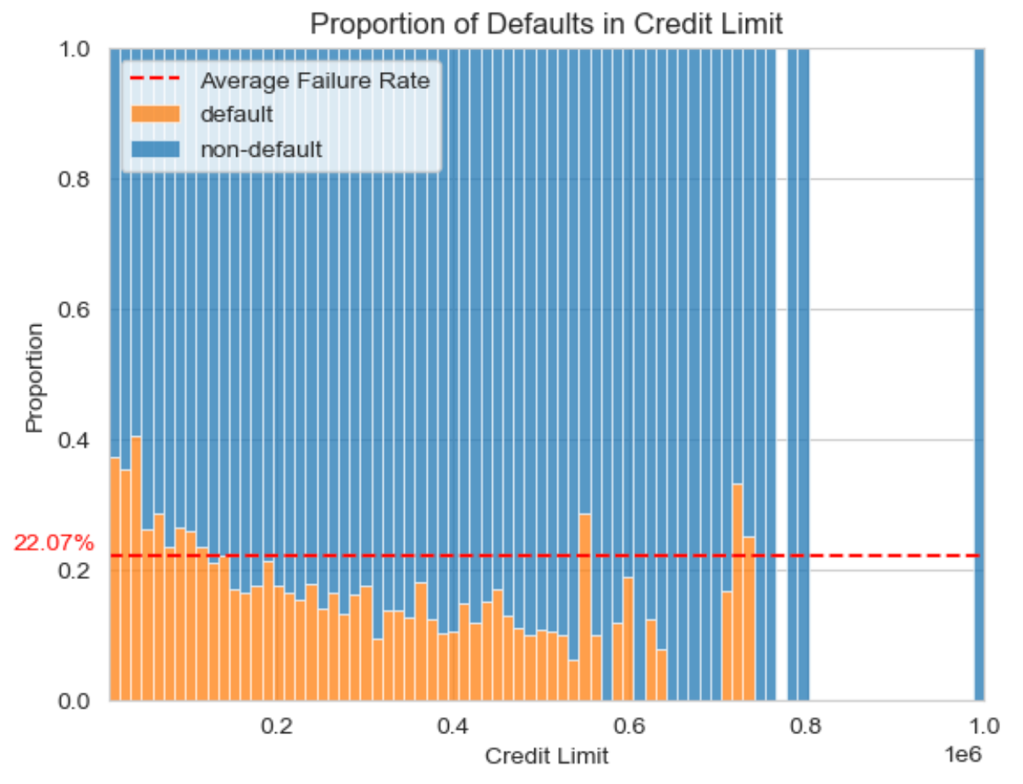
CREDIT LIMIT DEFAULTERS
Notes:
יצאנו מנקודת הנחה שיש

Slide 12
DATA ENGINEERING
MISSING VALUES:
NA'S: MARRIAGE- 0.18% NA,
EDUCATION - 0.05% NA
3 DIFFERENT Metrics: Remove, Knn, Binning
FEATURE ENGINEERING:
8 new features
Late payment (yes/no, count)
Std of bill/payment

Slide 13
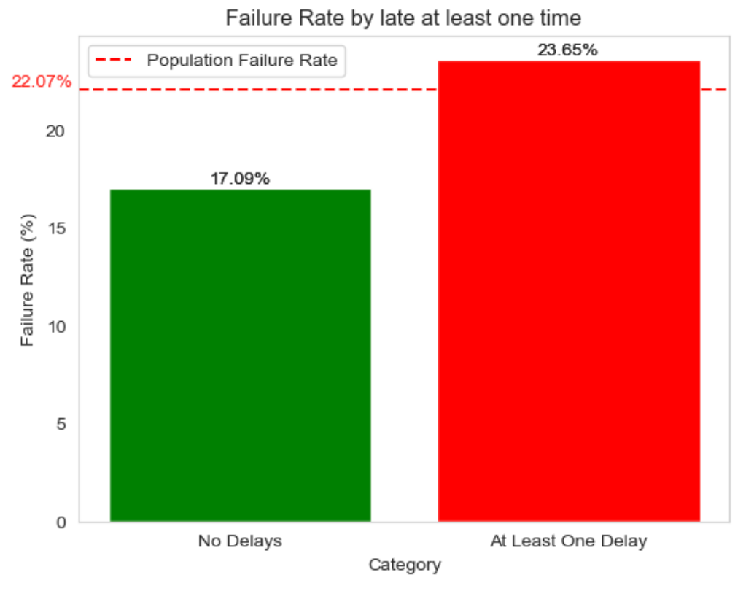
DEFAULT RATE FOR LATE CUSTOMERS

Slide 14
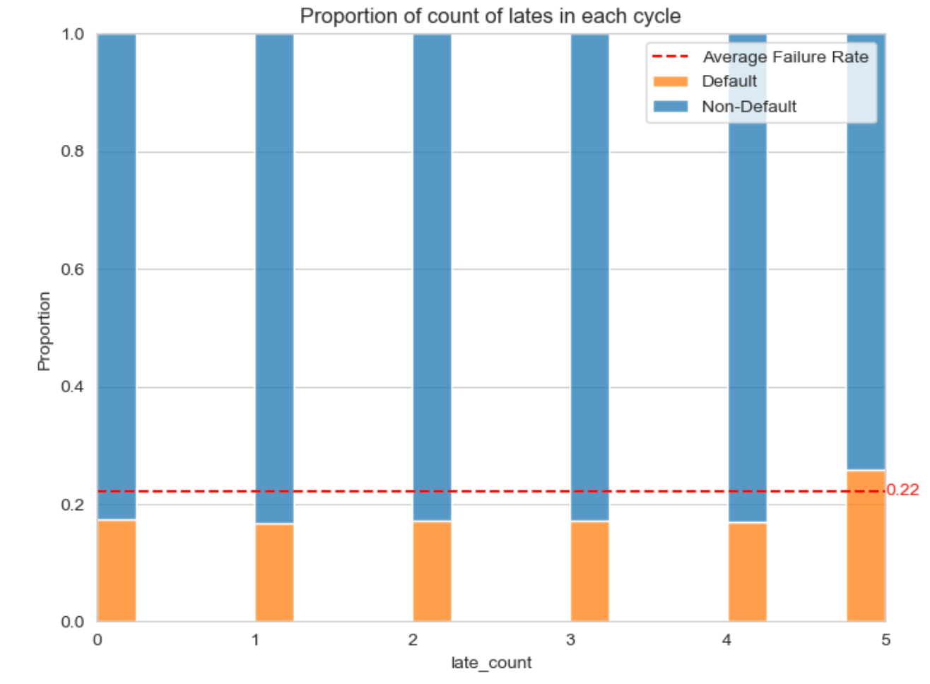
PROPORTION OF LATE COUNT

Slide 15
BASELINE MODEL
BASELINE MODEL
MAJORITY OF NON DEFAULT INSTANCES:
Training Accuracy: 0.77
Test Accuracy: 0.78

Slide 16
MODELING
Knn
Logistic Regression
Random Forest
Ada-Boost
SVM
PCA

Slide 17
MODELING
Knn
Assigns a class or value to a new data point based on the majority class or average of its nearest neighbors in feature space, using a predefined number of neighbors (k).

Slide 18
MODELING
Logistic regression
A statistical method used for binary classification tasks,
which predicts the probability that an instance belongs to a certain class.

Slide 19
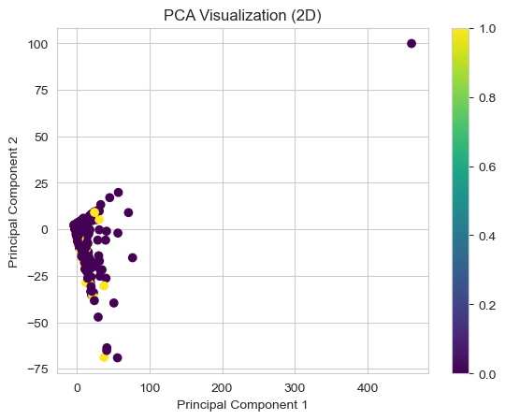
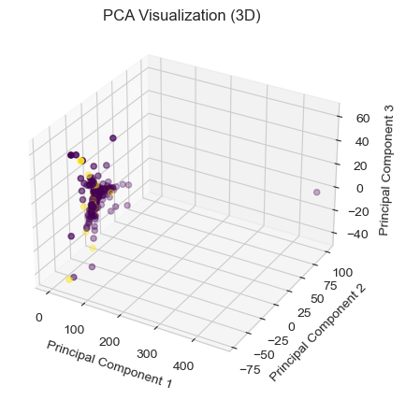
MODELING
PCA
Dimensionality reduction technique that transforms high-dimensional data into a lower-dimensional space while preserving the variance in the data, aiming to identify and represent patterns in the data efficiently.

Slide 20
MODELING
Random Forest
Group decision-making process where many decision trees (like different experts) vote on a prediction for each input, and the most popular choice wins. This helps to make accurate predictions while reducing the risk of making decisions based on just one tree's biases or errors.

Slide 21
MODELING
Adaboost
Adaboost combines multiple weak classifiers into a strong one by iteratively giving more weight to misclassified data, improving overall classification accuracy.

Slide 22
RESULTS

Slide 23
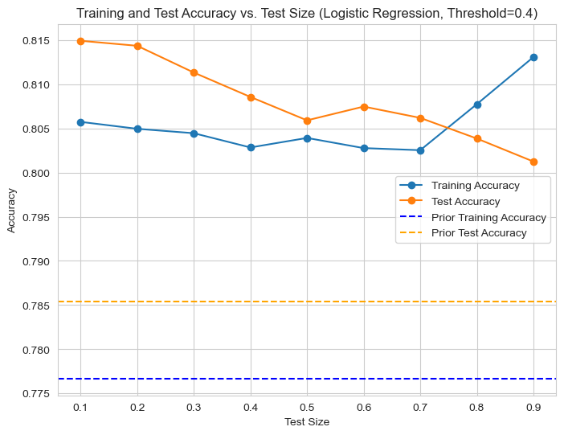
BEST MODEL vs BASELINE MODEL
Content
Department

Slide 24
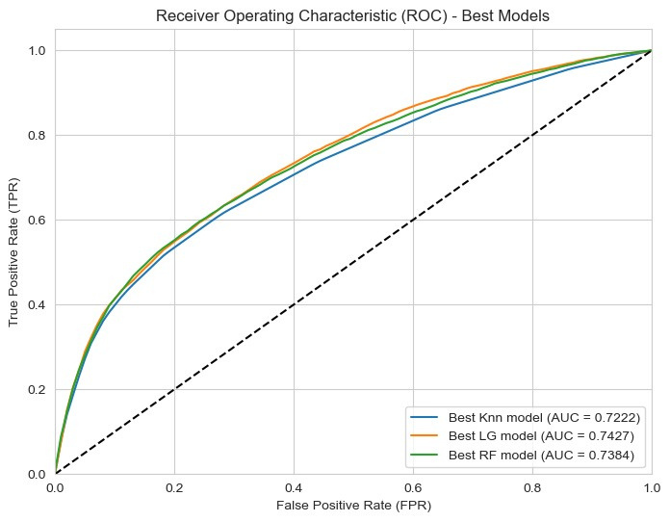
ROC CURVE
Content
Department

Slide 25
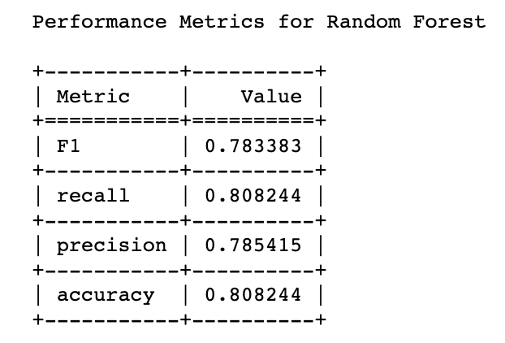
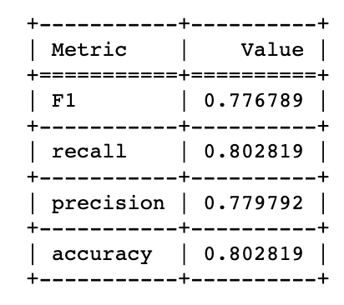
TIME IMPACT ANALYSIS
4 Months
6 Months
Content
Department

Slide 26
SVM
INITIALLY, WE ATTEMPTED TO RUN AN SVM MODEL- HOWEVER, DUE TO THE LARGE SIZE OF OUR DATASET, THE PROCESS DID NOT COMPLETE EVEN AFTER RUNNING FOR 5 HOURS.
CONSEQUENTLY, WE DECIDED TO APPLY THE PCA ALGORITHM TO REDUCE THE DIMENSIONALITY OF THE DATA.
UNFORTUNATELY, EVEN WITH PCA, THE MODEL FAILED TO FINISH RUNNING AFTER APPROXIMATELY 4 HOURS, LEADING US TO TERMINATE THE ATTEMPT.
WE DID IT BECAUSE CONSIDERED EXPLORING OTHER MODEL WITH DIFFERENT ASSUMPTIONS.

Slide 27
PROBLEMS AND CHALLENGES
WE FACED
SVM took alot of time and didnt finish after 4 hours
We lack certain qualities in our data
We had difficulty decoding the data and turning it into numbers
Data modeling took a long time
Learning to use new tool such as matplotlib to display the results

Slide 28
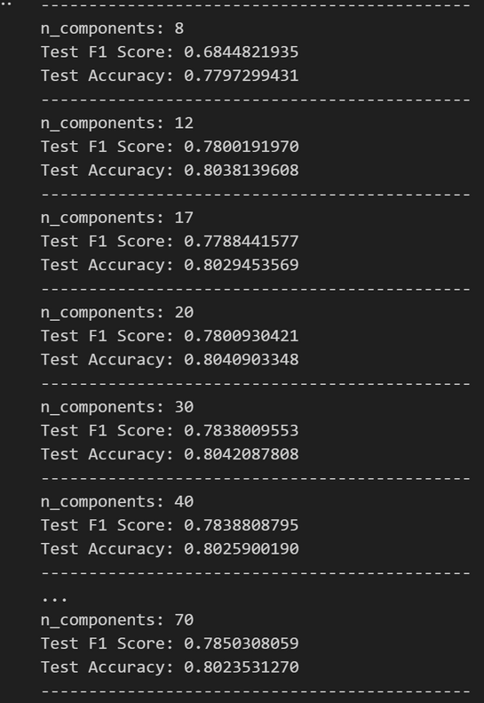
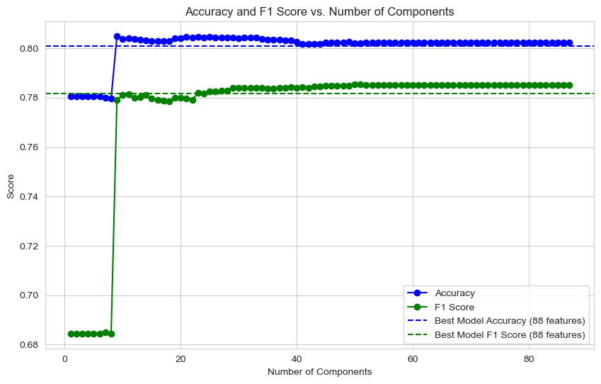
PCA ON OUR MODAL
It can be seen that for n_components smaller than 12 the accuracy and f1 are lower than our model now.
But as n_components increase, it can be seen that the indices improve slightly from our model.
Since we did not implement the code together, we will leave the model as it is at the moment.

Slide 29
CODE
GitHub link to our code:
https://github.com/MatanAdar/default-of-credit-card-clients

Slide 30

THANK YOU

